Slide 1
SMART BUILDING
INTERNET OF THINGS

Slide 2
Building components
Structure
Mechanical
Electrical
IT components
All are managed separately by different entities

Slide 3
Building Functions
Work areas with well lit
Comfortable temperatures
Safety with fire alarms
Door and physical security Alarms

Slide 4
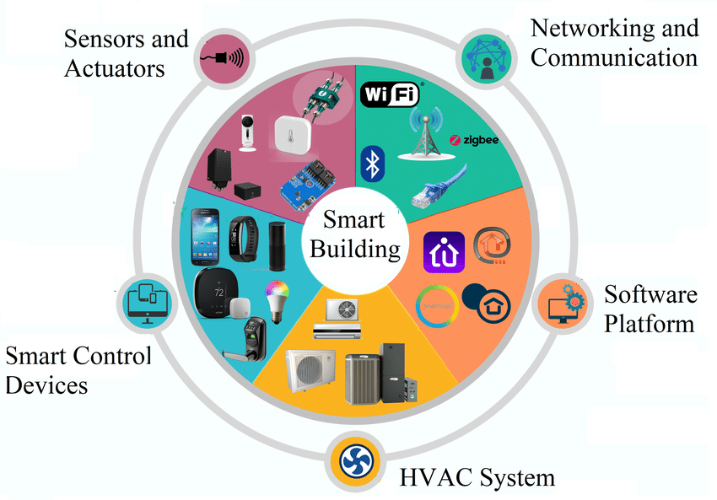
SMART BUILDING

Slide 5
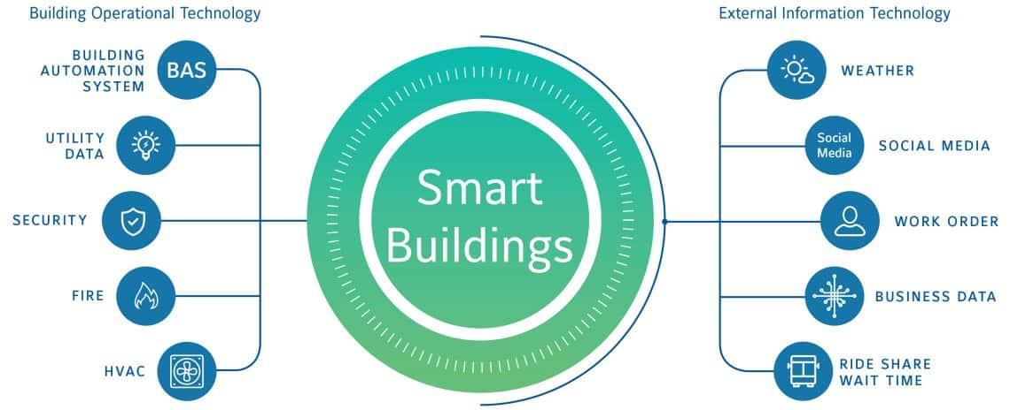
SMART BUILDING

Slide 6
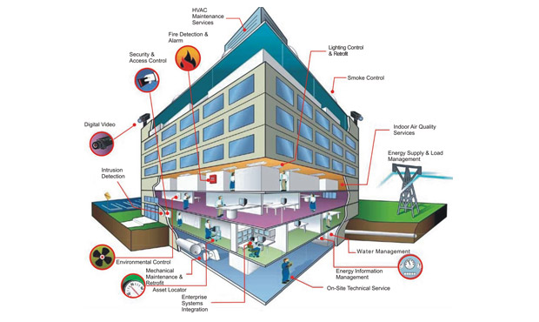
SMART BUILDING

Slide 7
Modern Building(IOT)
Deploy sensors throughout the building
Deploy system to provide people occupancy
Intelligent system to monitor and control various parameters (fire, smoke, lighting control ,indoor air quality, energy supply)
Intelligent communication system
Software platforms

Slide 8
Sensors in Smart Building
Motion detection sensor:
Tied to video cameras
To detect crowd occupancy in room
To switch ON OFF the various devices based on crowd occupancy
HVAC sensors
Heat, Ventilation and Air conditioning System
Temperature sensors
Helps Building Management System
Building Management System (BMS) controls AIR FLOW in the building

Slide 9
Smart Work Space
Workspace must be provided with
Sensors
Occupancy detection
Floor plan usage
Optimize work space
Efficient use of work space

Slide 10
BACnet in Smart Building
Building Automation and Control Network Protocol
Single management handles many operation like :
HVAC
Lighting access control
Fire alarm/Fire detection system
Various other detection systems
Provides ETHERNET based communication

Slide 11
Challenges in Smart Building
Bring all heterogenous systems together
Proper operations of Building Management System
Converge at the network layer
Convergence of IP network
Implementation of Building Automation Control net protocol efficiently
BACnet/IP allow “things” in the building network to communicate over IP, thus allowing closer consolidation of the building management on a single network
Devices can communicate with each other

